Slide 1
Today’s Agenda
Financial Scorecards
Pennies to P&Ls
Quiz
Notes:
We have had two fast-paced sessions with aggressive targets:
Class #1 life plan, 1-page business plan, vision, mission, key strategies
Class #2 project planning and risk management…all in one session!
Today we’re going to take it easy…and work on financials. Income Statements. Balance Sheets.
How many of you enjoy and are comfortable looking at financial reports?
Well today we are going to have fun doing just that.

Slide 2
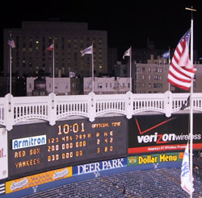
Financial Score Cards

Slide 3
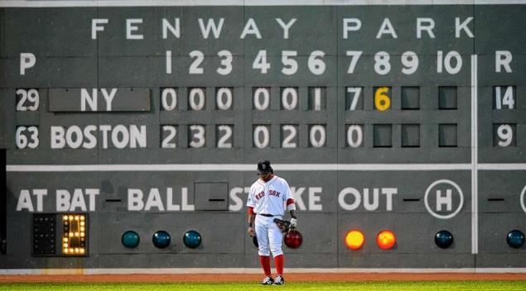
Financial Score Cards

Slide 4
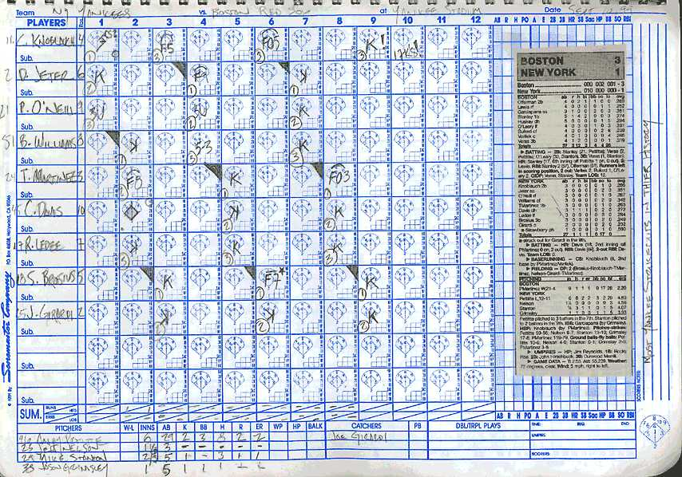
Financial Score Cards

Slide 5
Financial Score Cards
Income Statement
  AKA “Profit & Loss”
Balance Sheet
Notes:
In your business you have several score cards. We are going to cover two of them today – income statement (AKA P&L) and balance sheet

Slide 6
Income Statement
AKA Profit & Loss Statement, or P&L
Shows revenues, operating expenses, and net profit (…or net loss)
For a period of time
Revenues – Expenses = Net Income

Slide 7
Balance Sheet
Snapshot at a point in time
It Balances

Slide 8
Balance Sheet
What your company OWNS
What your company OWES
What’s left OVER
What you OWN – what you OWE
= What’s left OVER

Slide 9
Balance Sheet
What your company OWNS
What your company OWES
What’s left OVER
What you OWN =
What you OWE + What’s left OVER

Slide 10
Balance Sheet
Assets = What your company OWNS
Liabilities = What your company OWES
Net Worth = What’s left OVER
Assets = Liabilities + Net Worth

Slide 11
Pennies to P&Ls

